Slide 1
GOOGLE MERCHANDISE SALES DATA ANALYSIS
Notes:
Hello Everyone!
We are group 4 and we are presenting our analysis of data from google merchandise store.

Slide 2
TABLE OF CONTENTS
01
02
ABOUT US
UNDERSTAND DATA
03
04
ANALYSIS
ASSOCIATIONS
Notes:
The agenda of this presentation is to introduce the team, discuss about the data, present our analysis and associations.

Slide 3
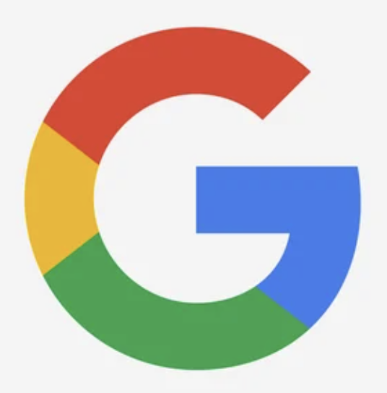




TEAM: Group 4
Rajat Chopra
. Anjali
Silky Batra
Anubhav Agarwal

Slide 4
TEAM: Group 4
Anubhav Agarwal
Silky Batra
. Anjali
Rajat Chopra
Notes:
The team consists of Anjali, Silky, Anubhav and myself.

Slide 5
Data Source
https://observablehq.com/@observablehq/google-merchandise-sales-data
The notebook contains a curated subset of the anonymized google Analytics event data for three months of the Google Merchandise store.
We have three tables
Items
Events
Users
Notes:
Let me start by telling you about the data source.
We have used three months of data from Google merchandise store. The original or the superset of the data exists as a BigQuery dataset.
However, for this presentation, we have used a synthesised version of the same.

Slide 6
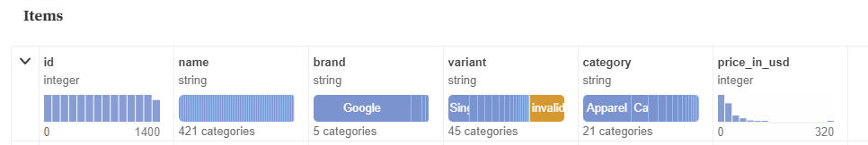
Items
The items table has entries for each item, though you may notice that two items
may share the same name if they differ in another attribute like variant.
Perhaps the most interesting field for analysis is the 'price_in_usd' for each item.
Notes:
The items table consists of fields such as name, brand, variant and price.

Slide 7
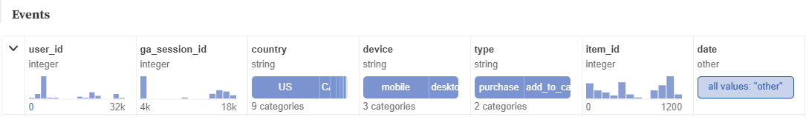
Events
The events table is the meat of this dataset, representing one of the most common use cases in analytics. The database captures three event types :
Add_to_cart
Begin_checkout
Purchase
Each event has a unique user_id and session_id along with the device type.
Notes:
The events table is the most important table for us. It consists of three event types - Begin_checkout, add_to_cart and purchase.
Each entry has a unique user_id and session_id associated with it. This will help us track user purchases

Slide 8
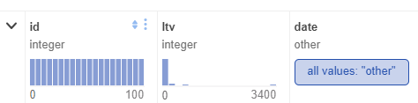
Users
The users table has fields
Id
Ltv : lifetime value in USD
Date of first touch

Slide 9
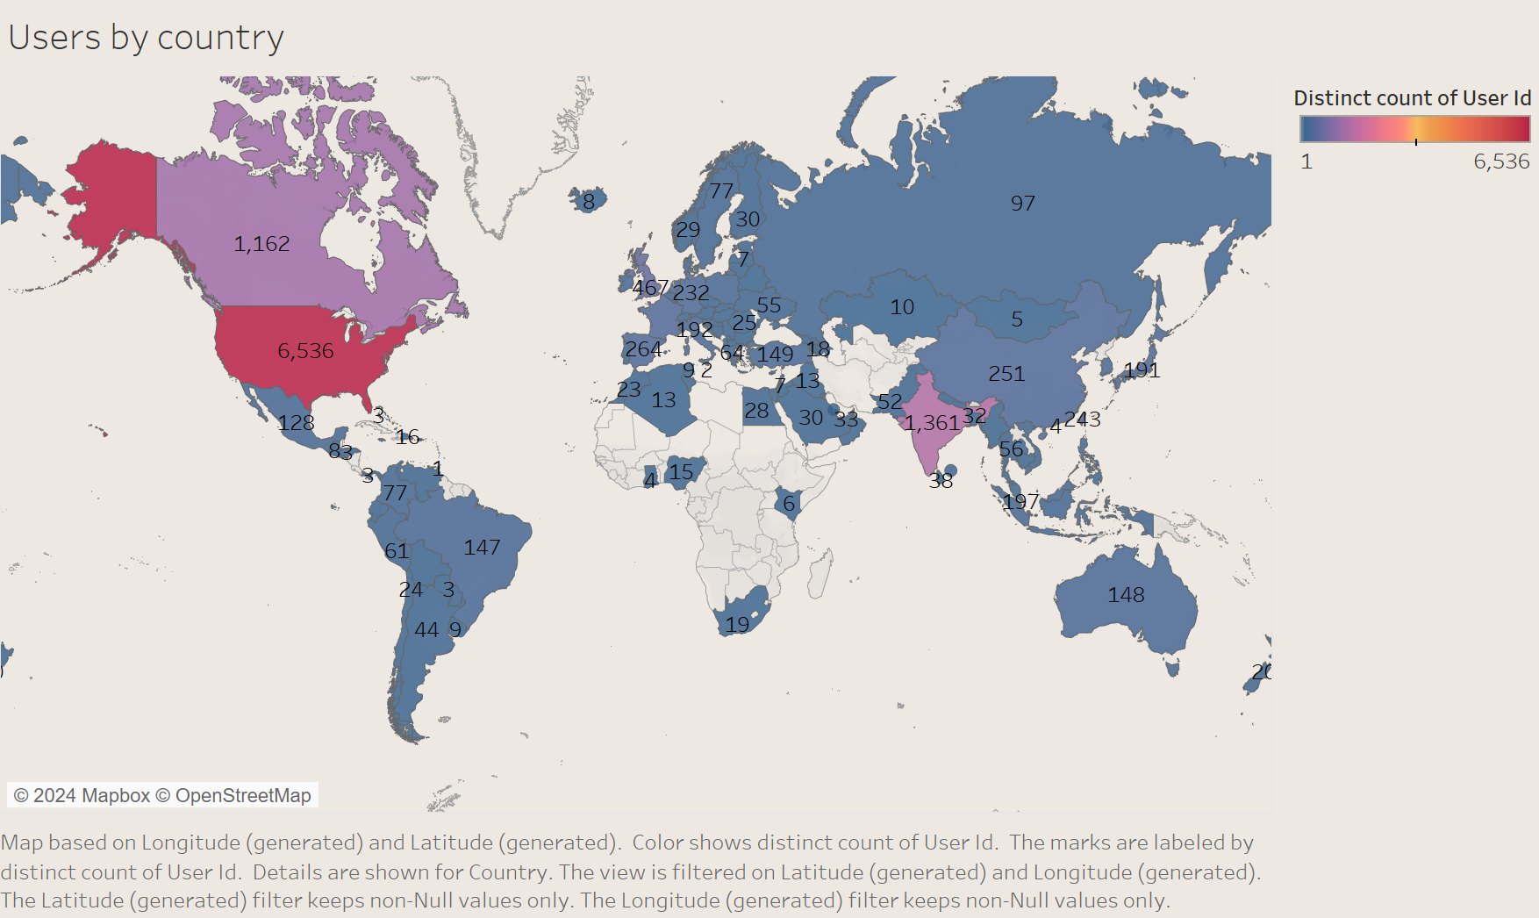
Our Top 3 countries where users belong are USA, India and Canada

Slide 10
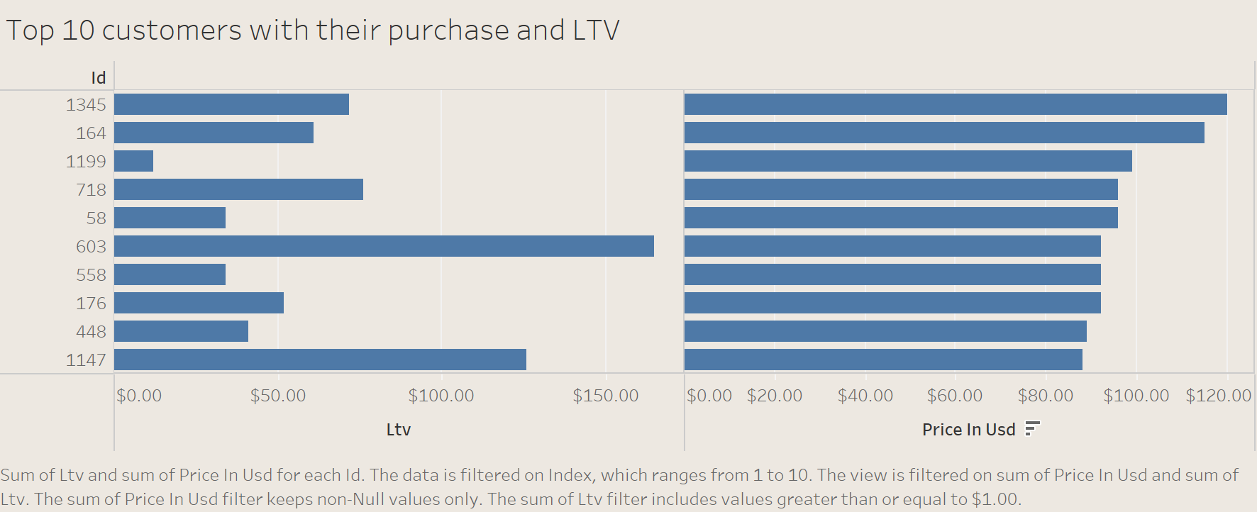
The LTV predicted differs significantly with the actual amount purchased

Slide 11
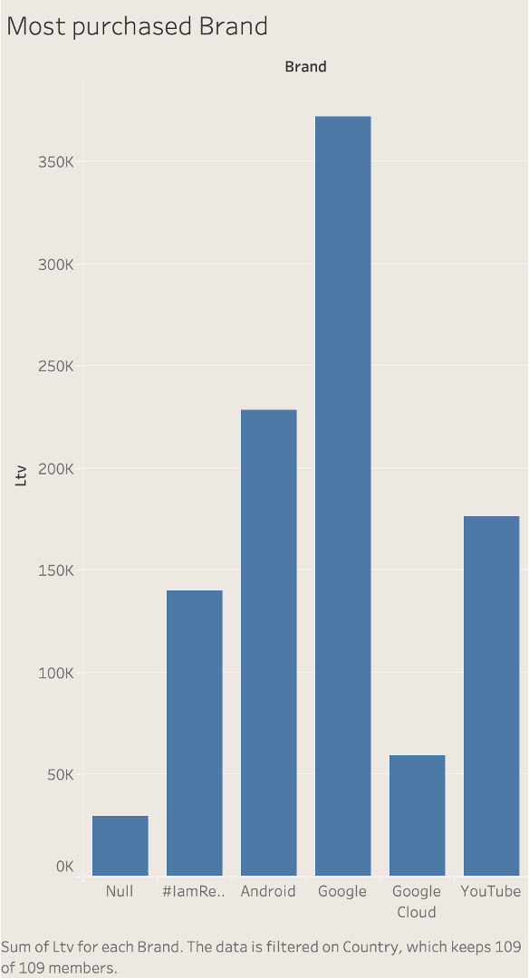
The product portfolio in terms of Brand
Notes:
When we explore the items and events dataset, we discover that the Google Merch store has been divided in various classes named brands based on which google product they are advertising. We focus only on purchase data to analyze the revenue sources.

Slide 12
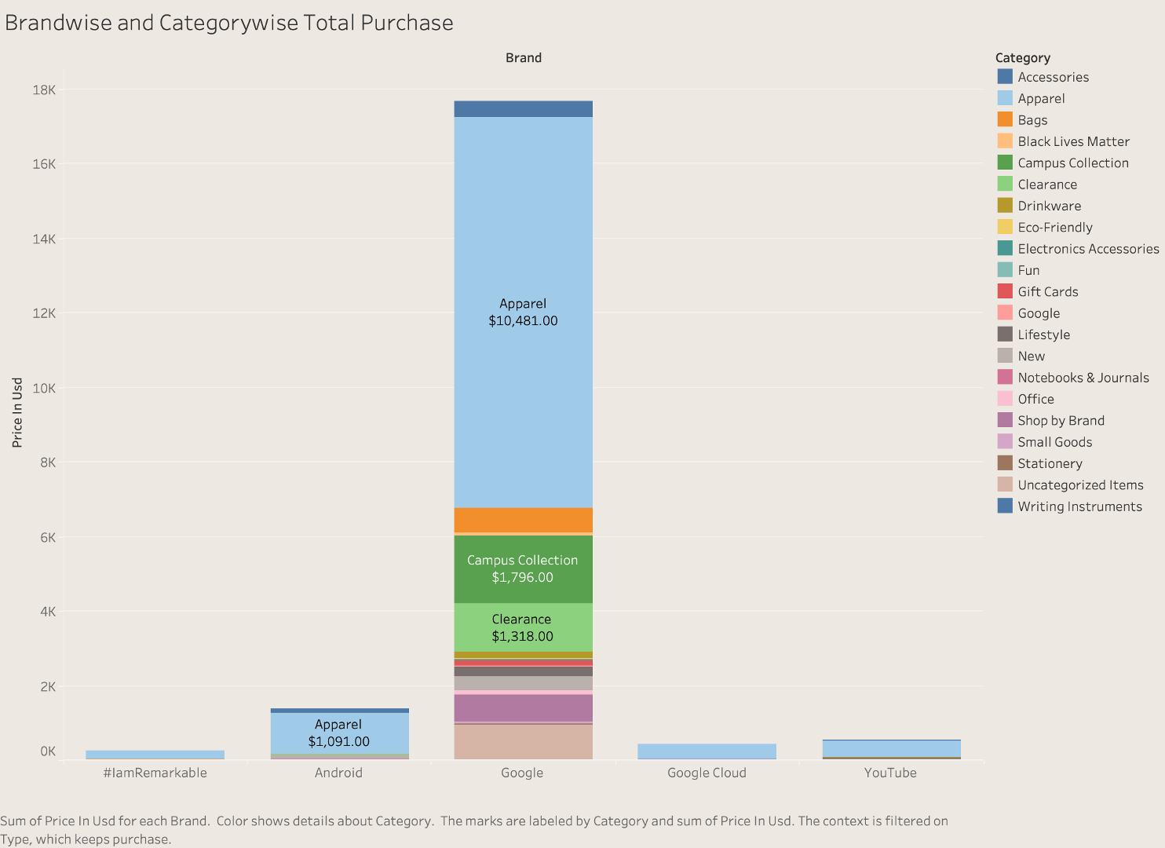
Brand wise and Category wise Total Purchase
Notes:
We deep dive the same sales distribution now to see which categories are more popular across all brands. We see that Apparel dominates all the categories in each brand.

Slide 13
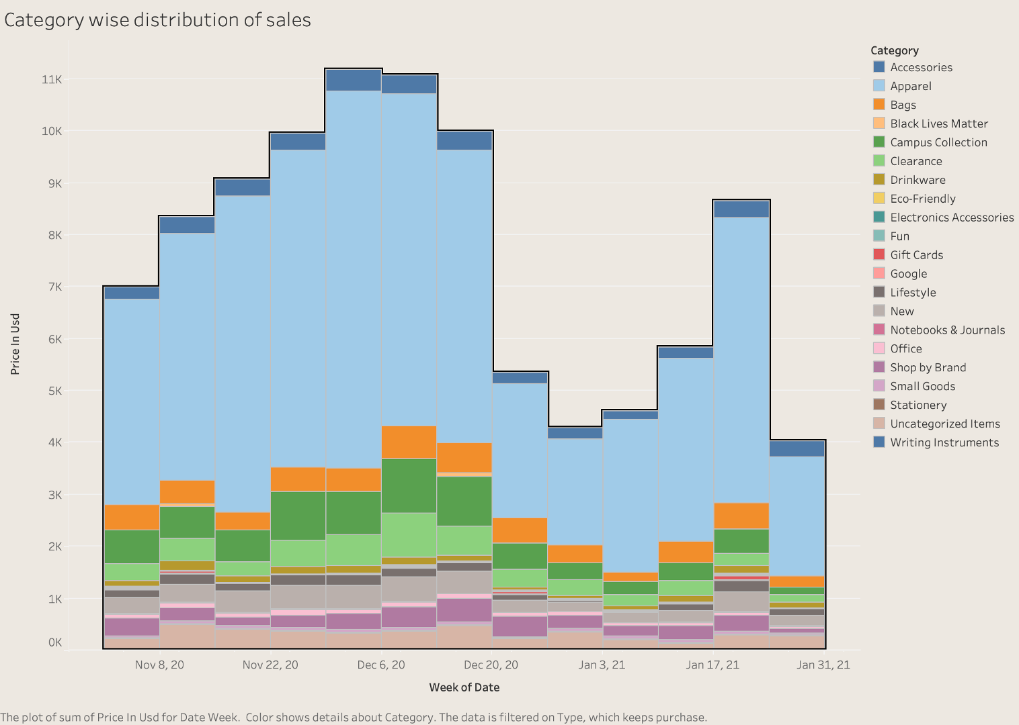
Category wise Timeseries Distribution of Sales
Notes:
After exploring through the category of products, we proceed to see the timeline of purchases made. We find that the domination of apparel purchasing is evenly distributed throughout the time interval being studied

Slide 14
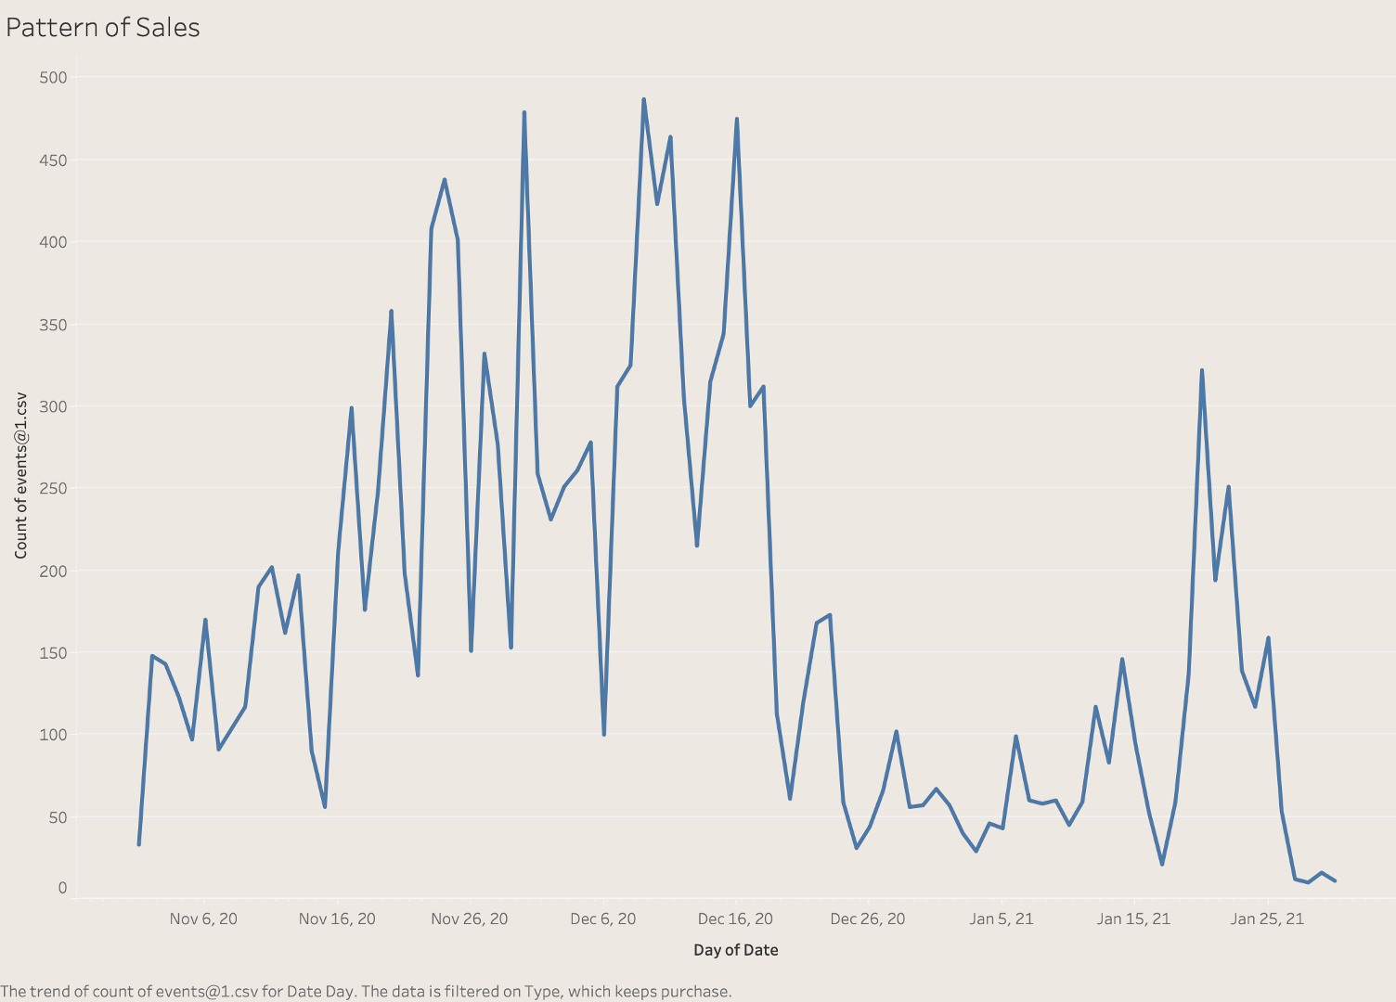
Pattern of Sales
Notes:
Further, to discuss about the sales pattern, we see sales spike during the last week of November, Mid December and Jan end. These spikes could be attributed to events like Black Friday, Early shopping for Christmas and New Year or Google purchasing gifts for new hires

Slide 15
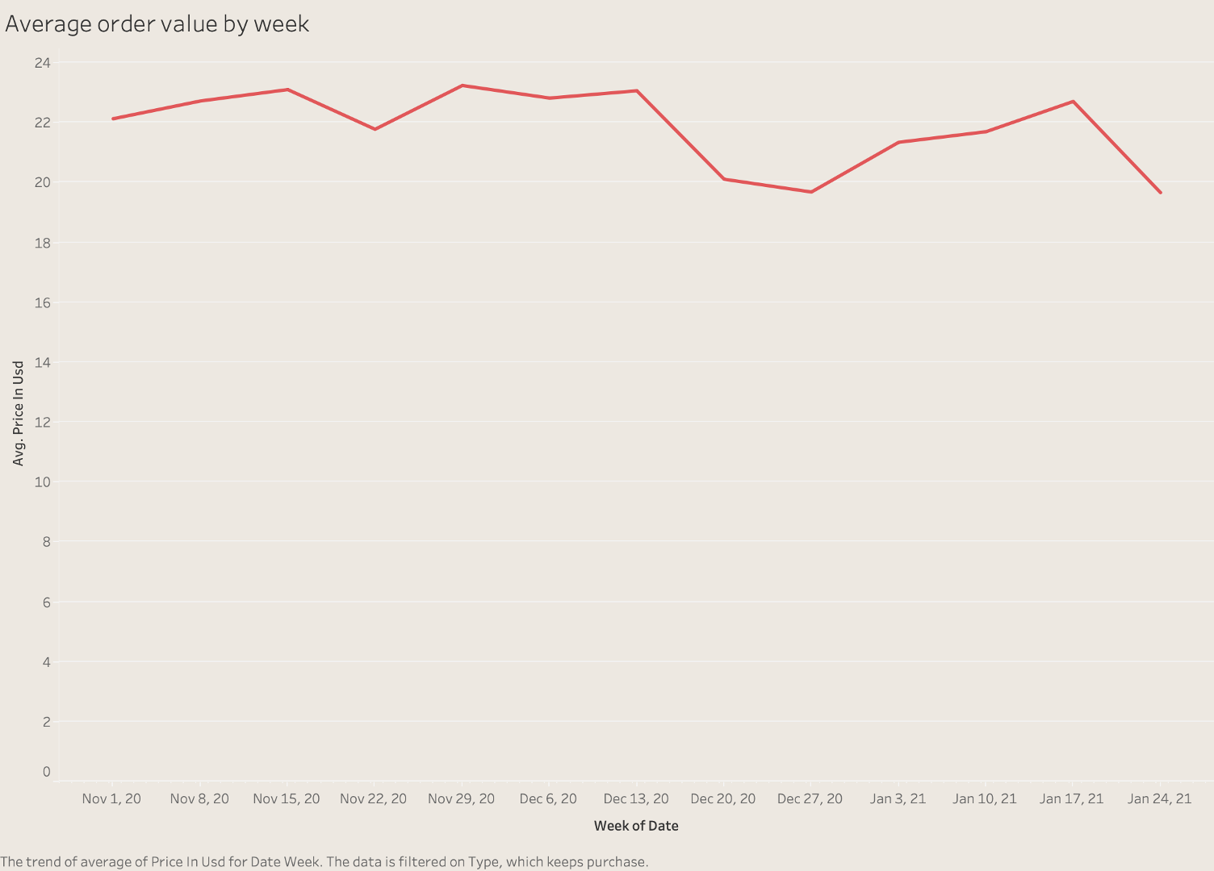
Average Order Value By week
Notes:
Another interesting insight worth noting is that the average order value by week doesn't take a significant dip. The purchase amount is almost uniform with apttern smatching the earlier sales graph. That's all from my end.

Slide 16
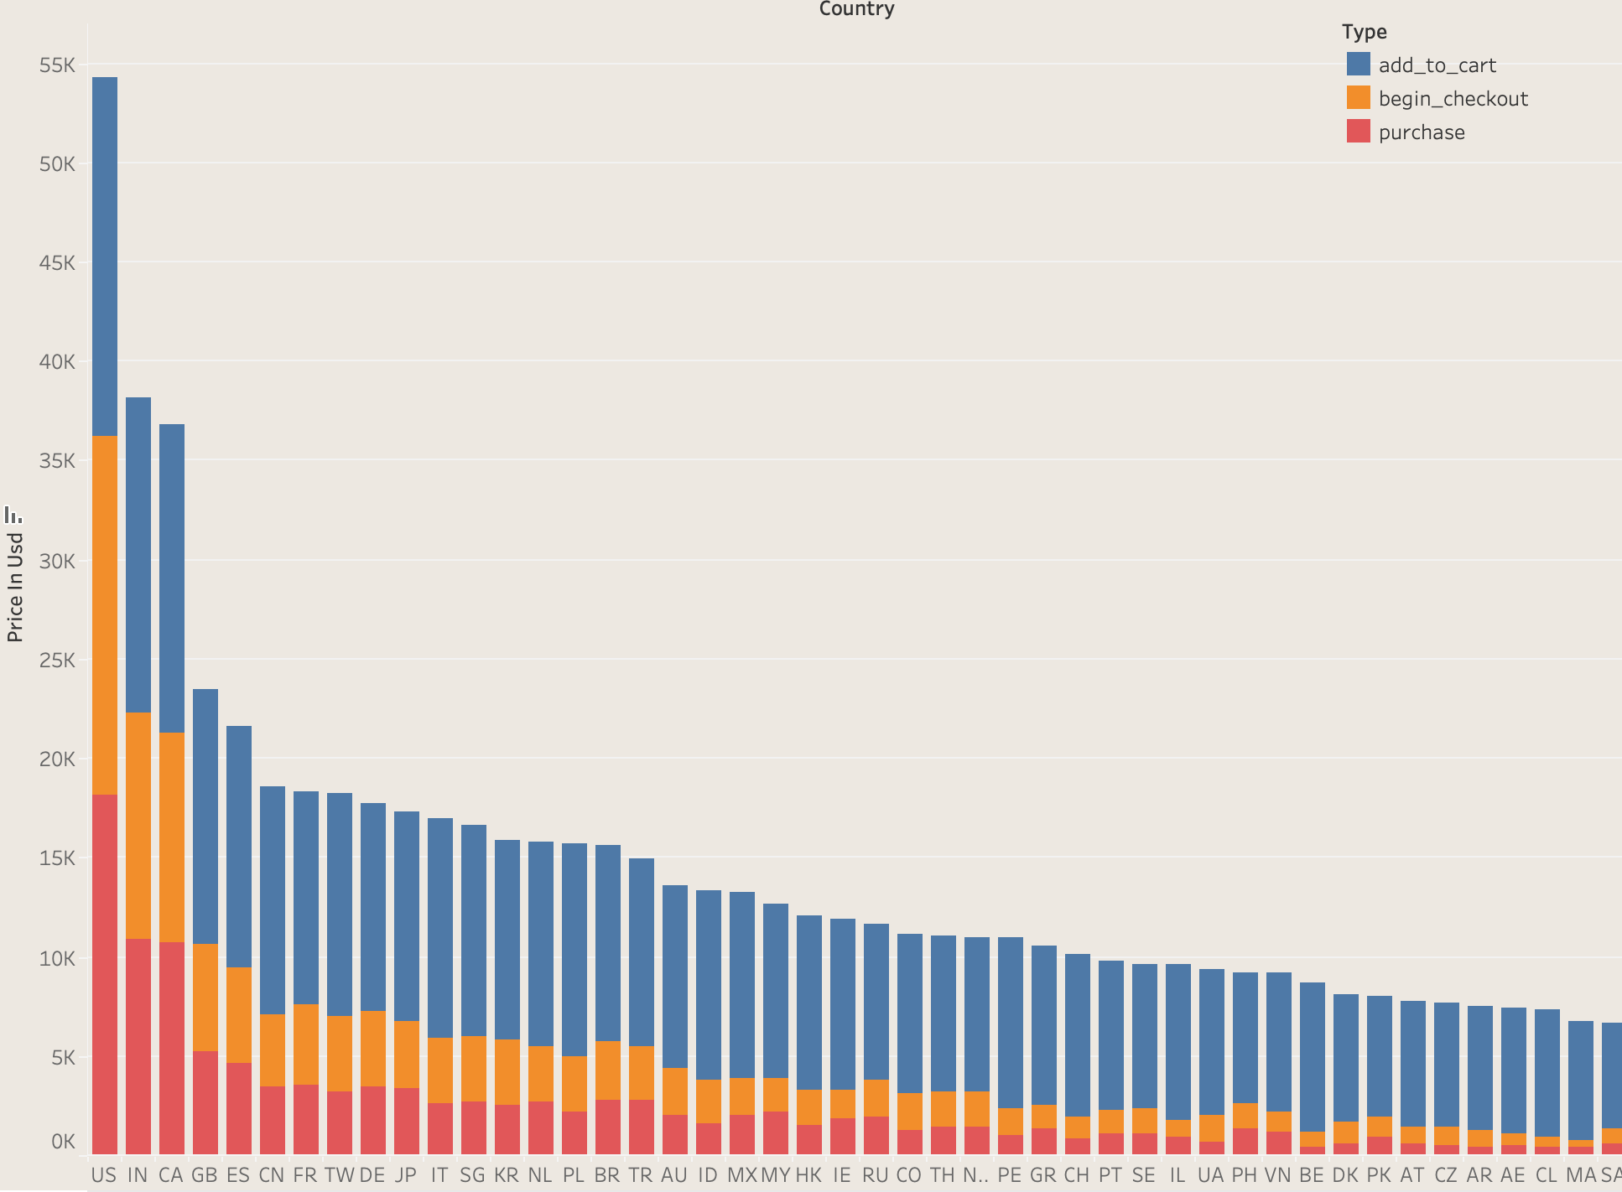
Comparison of Purchase/Add to Cart/Checkout for each country

Slide 17
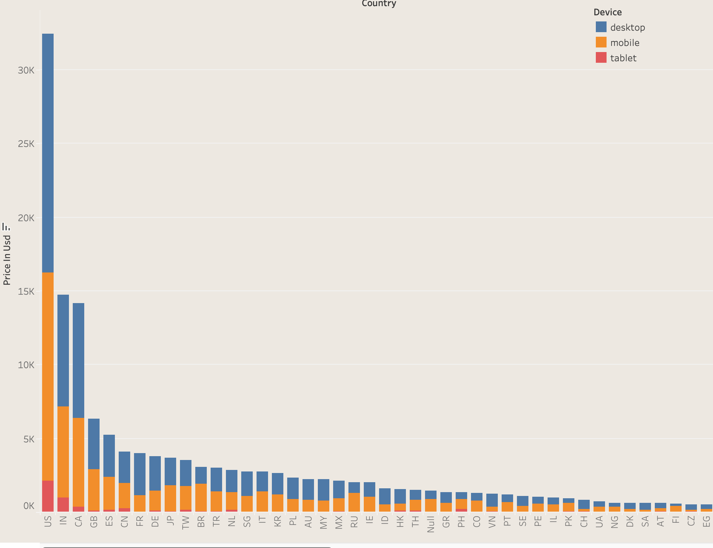
Comparison of device used to purchase country-wise

Slide 18
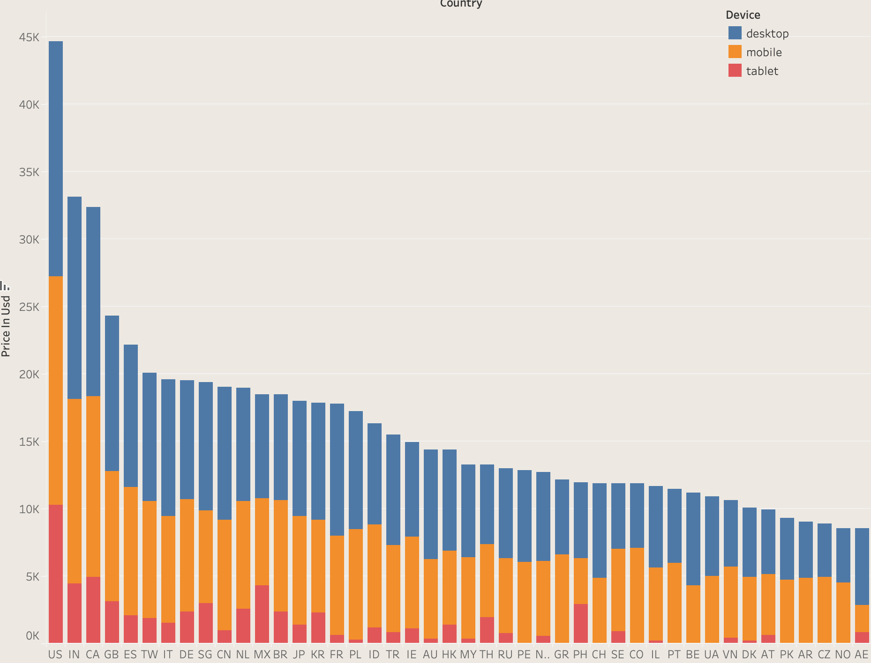
Comparison of device used to add to cart country-wise

Slide 19
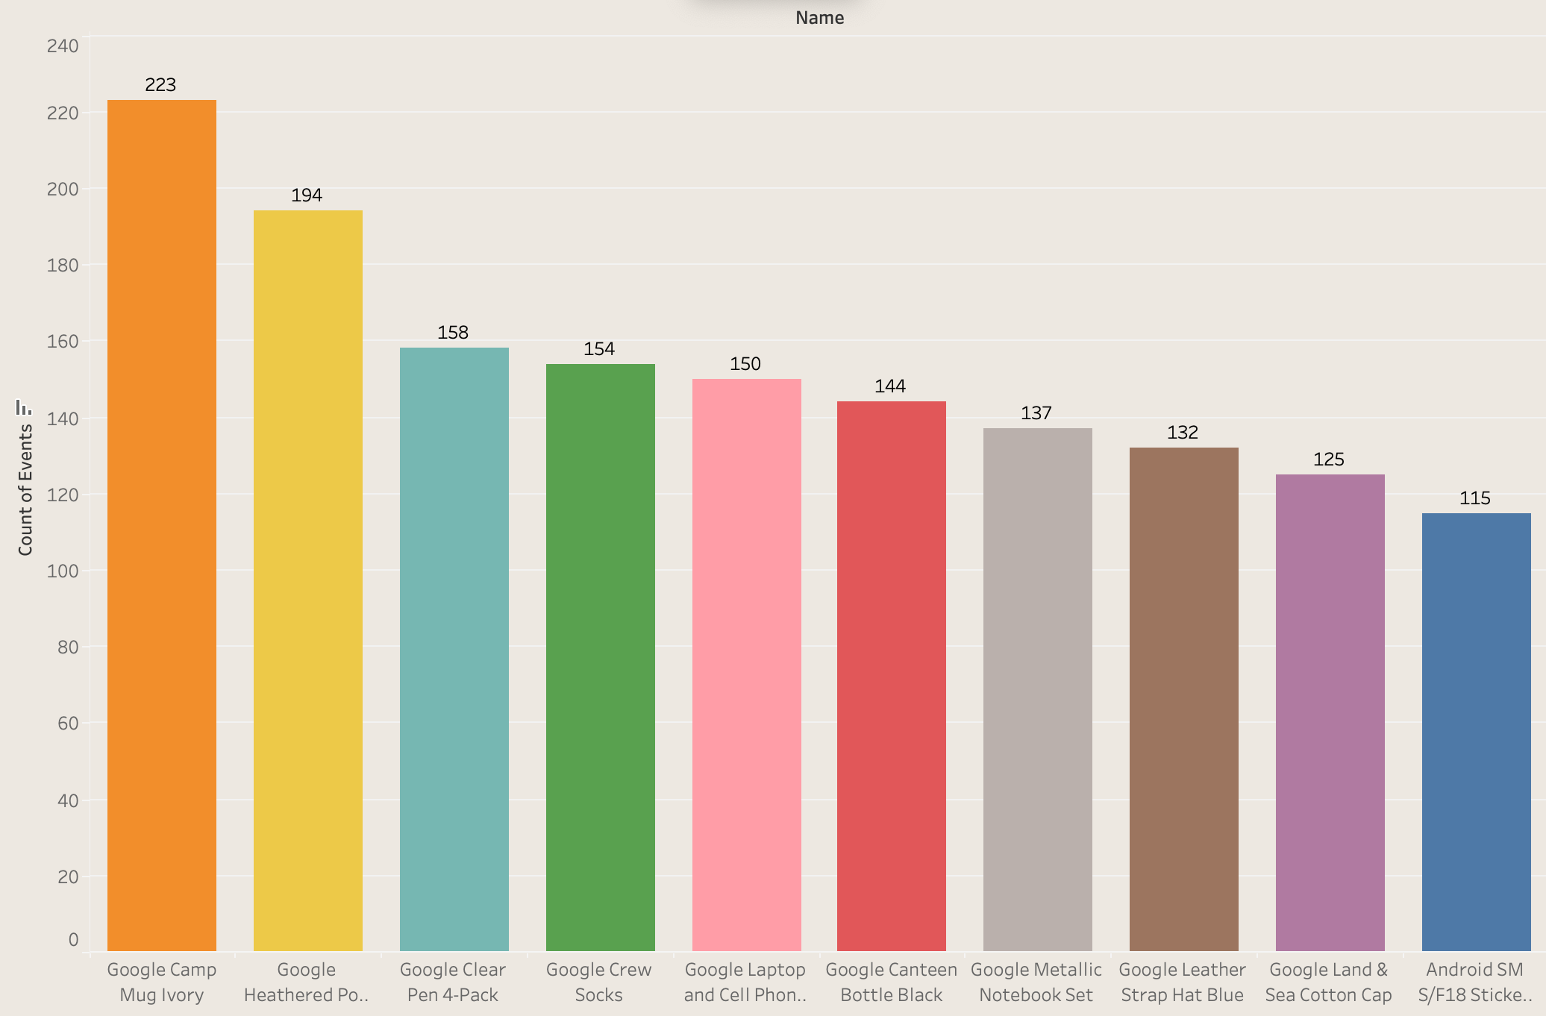
Top 10 items purchased

Slide 20
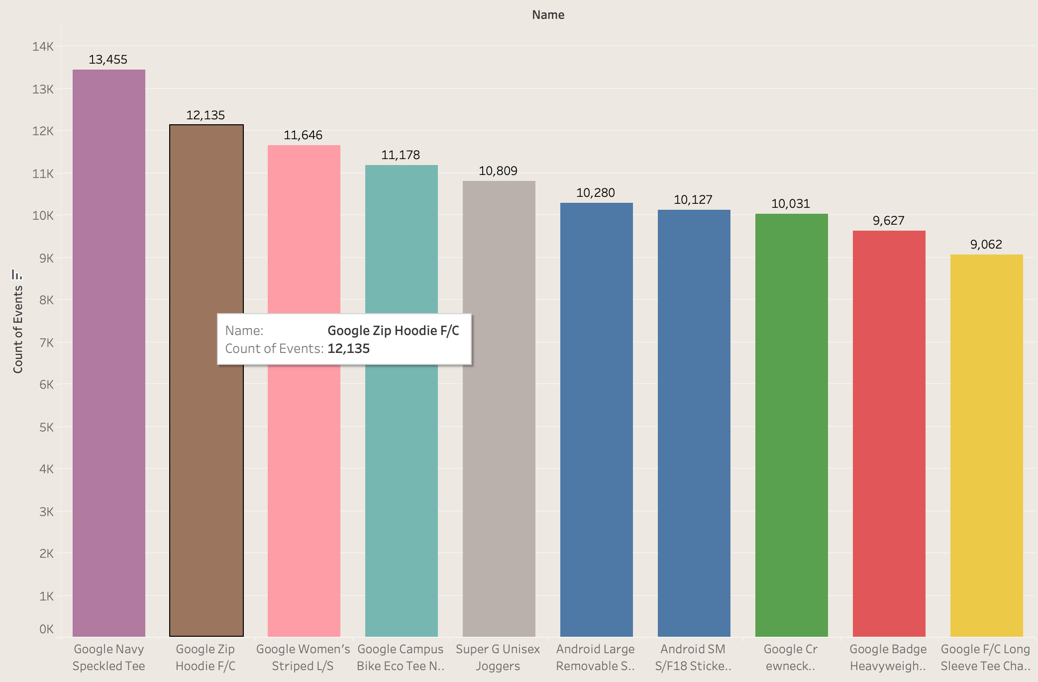
Top 10 items added to cart

Slide 21
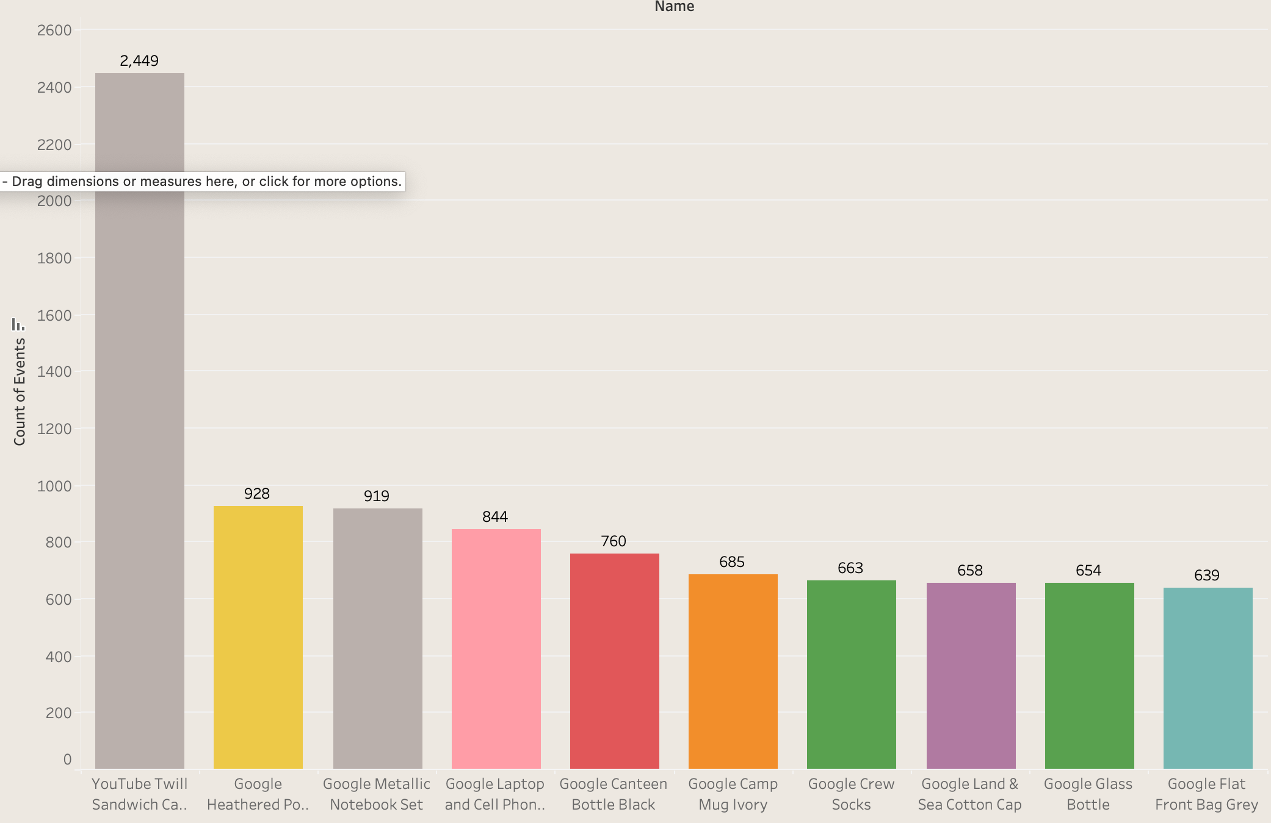
Top 10 items with begin checkout

Slide 22
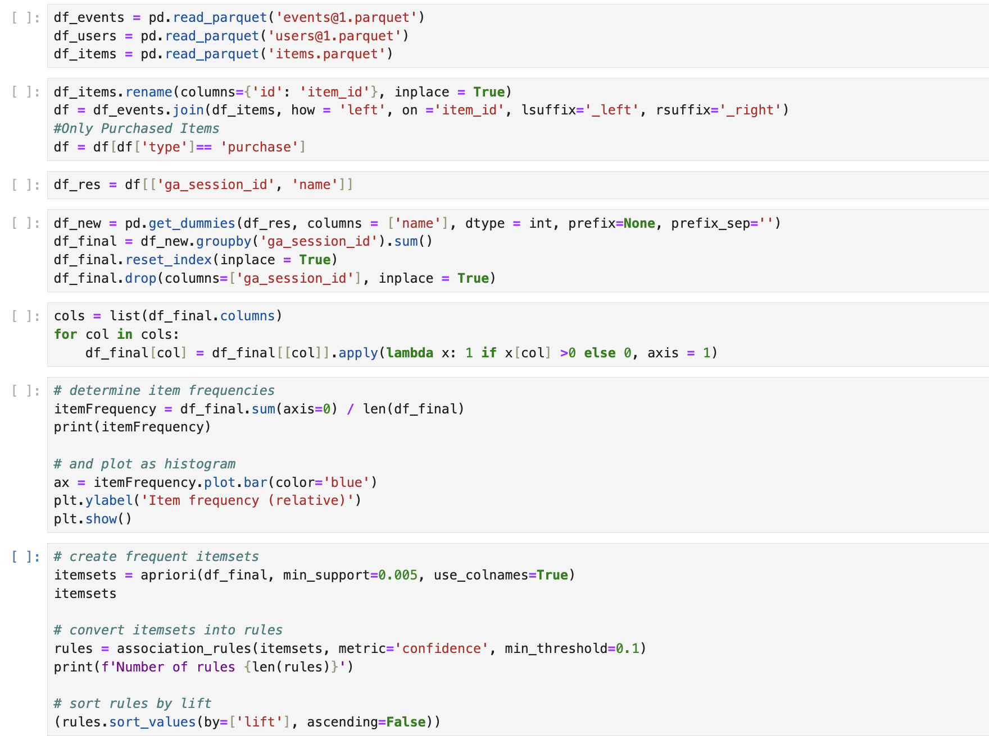
Find Associations using Python

Slide 23
Associations found
1 | 2 | 3 | 4
Android Large Removable Sticker Sheet Android SM S/F18 Sticker Sheet | Google Clear Pen 4-Pack Google Metallic Notebook Set | Google Crew Combed Cotton Sock Google Crew Socks | Google Light Pen Blue' Google Light Pen Green Google Light Pen Red

Slide 24
THANK YOU!
ANY QUESTIONS?

